Slide 1
TG 218: Tolerance limits and methodologies for IMRT measurement-based verification QA
Radiation Oncology
Daniel Alexander
(Presentation adapted from Julia Pakela and Khayrullo Shoniyozov)
July 20th, 2023

Slide 2
History of IMRT
Conceptualized in early 90s; first clinical experiences and QA/commissioning reported in 1996
IMRT treatments feature “complex” fluence modulation; provides additional degrees of freedom with which to optimize dose distribution
Delivery methods:
Fixed gantry (step and shoot, dynamic)
Moving gantry (VMAT, tomotherapy)
IMRT dose distributions are typically much more heterogeneous than those of 3D plans, employing complex fields that incorporate different degrees of modulation.

Slide 3
Purpose of patient-specific IMRT verification QA
Determine discrepancies between the planned and delivered doses
Detect gross errors in radiation delivery
‘Run through’ of the clinically delivered plan to ensure the safety of the patient
IMRT QA does not check the TPS algorithm’s management of heterogeneities, segmentation errors, or patient position errors

Slide 4
Topics of TG 218: Review the different ways to perform IMRT QA
Review of verification metrics (dose difference, DTA, γ analysis)
Review of plan measurement methods: Composite beam, perpendicular composite, and perpendicular field by field
Review absolute dose verification methods: single point, 1D/2D analysis methodologies for absolute dose difference with ion chamber or 2D detector arrays
Review literature on expected achievable agreement between measured and calculated dose for different vendor systems and implementations (see extra slides)
Recommend Methods and Tolerance/Action Limits for Implementing IMRT QA
*Everything in TG-218 assumes a proper commissioning of your IMRT program (TG-119/120)

Slide 5
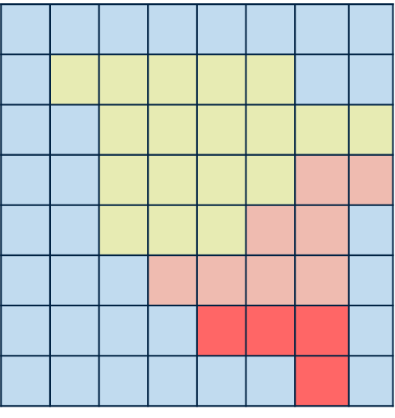
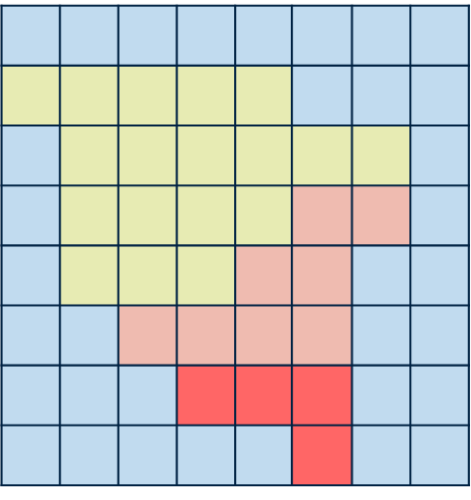
IMRT QA - What are we analyzing?
Dose distribution = array of points with location and dose value
Spatial resolution does not need to be isotropic
Interpolation occurs for displays with dose wash or isodose lines
Comparing two dose distributions – a “reference’ and an “evaluated” dose.
Do reference and evaluated dose distributions agree to within limits that are clinically relevant?
Some techniques are invariant with respect to the selection of the reference and evaluation distribution, others are not
Two approaches to comparing dose distributions
Dose difference
Very (overly) sensitive in steep dose gradients
Distance to agreement (DTA) or contour overlay
Overly sensitive in low dose gradient regions

Slide 6
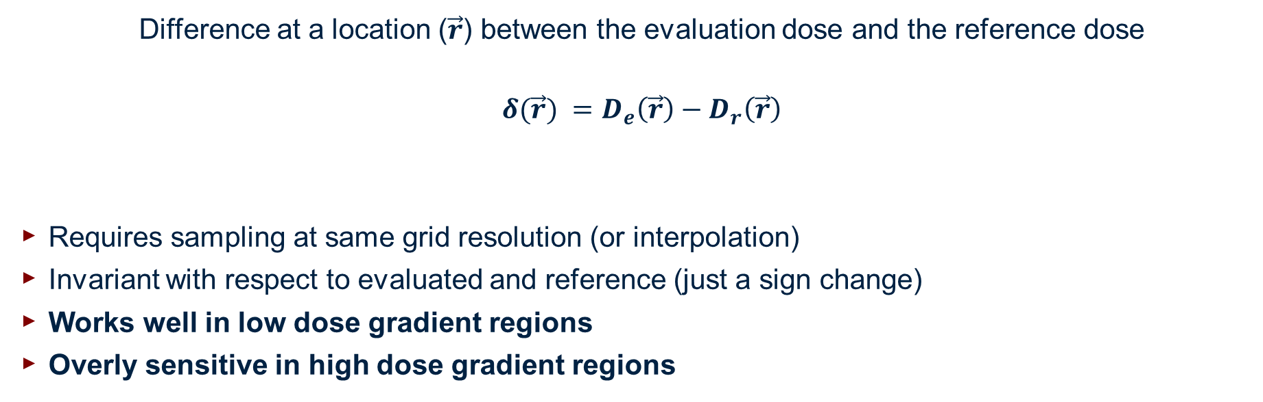
The dose difference test
Difference at a location ($\vec{r}$) between the evaluation dose and the reference dose
$${δ(\vec{r}) =D}_{e}\left(\vec{r}\right)−D_{r}\left(\vec{r}\right)$$
Requires sampling at same grid resolution (or interpolation)
Invariant with respect to evaluated and reference (just a sign change)
Works well in low dose gradient regions
Overly sensitive in high dose gradient regions
D
x

Slide 7
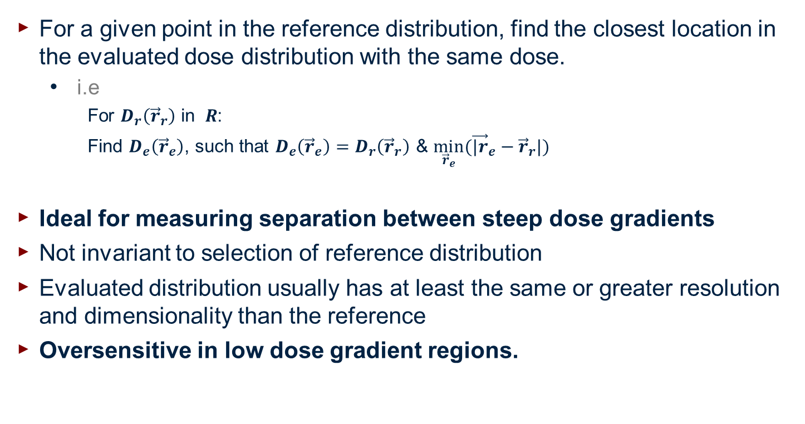
Dose to agreement (DTA)
For a given point in the reference distribution, find the closest location in the evaluated dose distribution with the same dose.
i.e
For $D_{r}\left({\vec{r}}_{r}\right)$ in $R$:
Find $D_{e}\left({\vec{r}}_{e}\right)$, such that $D_{e}\left({\vec{r}}_{e}\right)=D_{r}\left({\vec{r}}_{r}\right)$ & $\min_{{\vec{r}}_{e}}{({\vec{|r}}_{e}−{\vec{r}}_{r}|) }$
Ideal for measuring separation between steep dose gradients
Not invariant to selection of reference distribution
Evaluated distribution usually has at least the same or greater resolution and dimensionality than the reference
Oversensitive in low dose gradient regions.
D
x
Van Dyk et al., 1993; Harms et al., 1998

Slide 8
Composite test
Pass
DTA
Pass ​
Dose
Pass
Test
Takes advantage of fact that DTA and dose measurement tests are complimentary in respect to their usefulness in high/low dose gradient regions
Binary output – does not give quantitative information
By how much did we fail?
Fail
DTA
Pass ​​
Dose
Pass ​
Test
Pass
DTA
Fail
Dose
Pass
Test
Fail
DTA
Fail
Dose
Fail Test

Slide 9
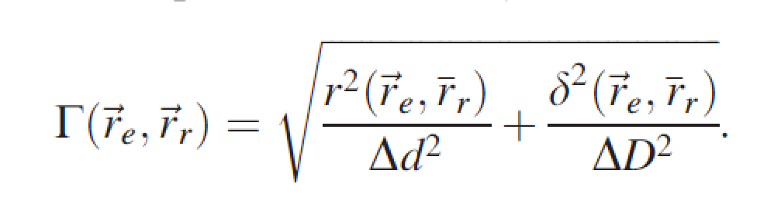
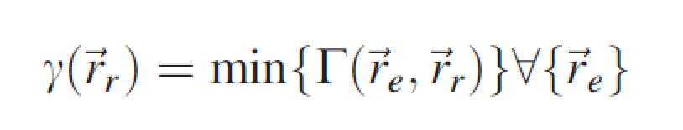


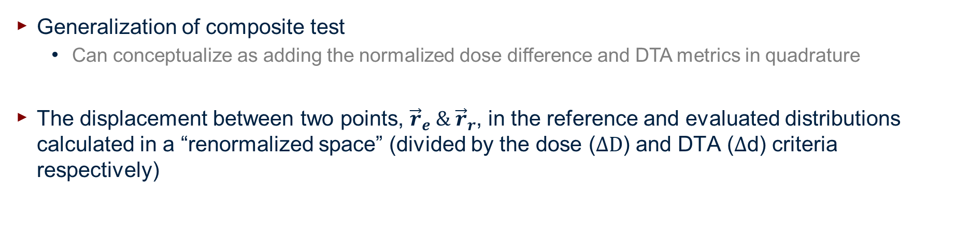
The γ (gamma) test
Generalization of composite test
Can conceptualize as adding the normalized dose difference and DTA metrics in quadrature
The displacement between two points, ${\vec{r}}_{e} \& {\vec{r}}_{r}$, in the reference and evaluated distributions calculated in a “renormalized space” (divided by the dose ($ΔD$) and DTA ($Δ$d) criteria respectively)
Distance between the reference and evaluated point
Dose difference between reference and evaluated point
Low et al. 1998, Low et al. 2003

Slide 10
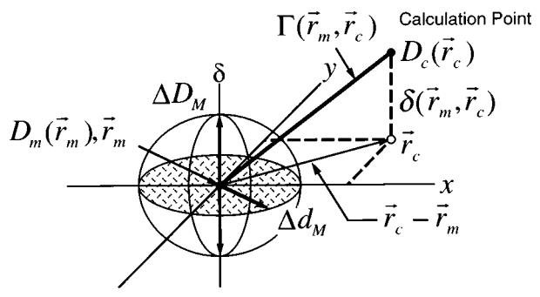
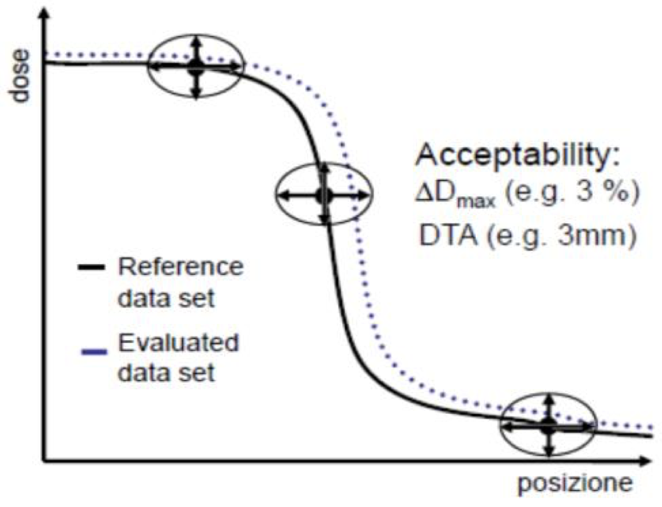
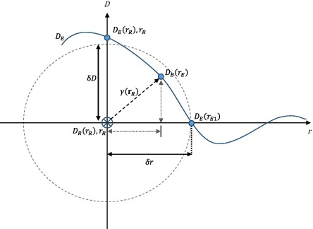
The γ (gamma) test – visual representation

Slide 11
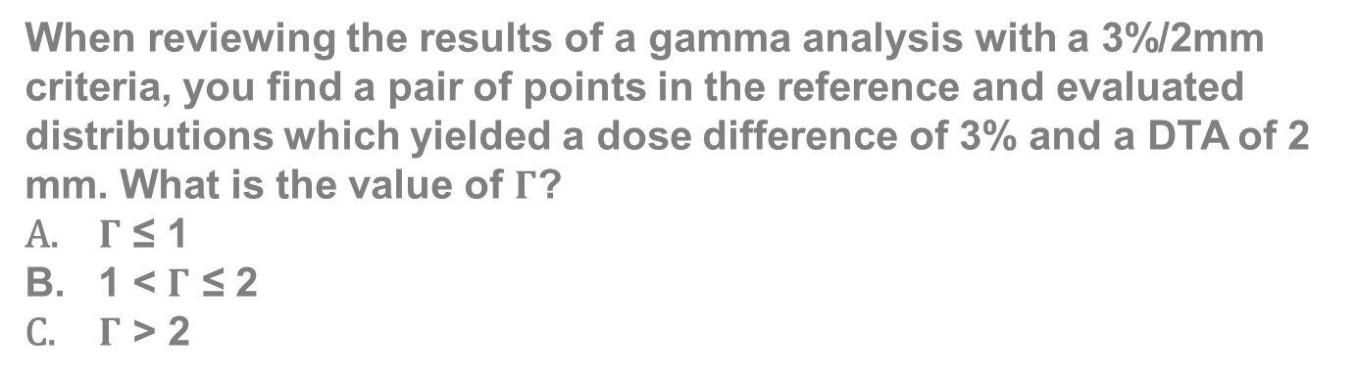
Question for the audience:
When reviewing the results of a gamma analysis with a 3%/2mm criteria, you find a pair of points in the reference and evaluated distributions which yielded a dose difference of 3% and a DTA of 2 mm. What is the value of $Γ$?
$Γ$ ≤ 1
1 < $Γ$ ≤ 2
$Γ$ > 2

Slide 12

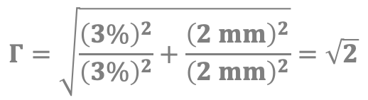
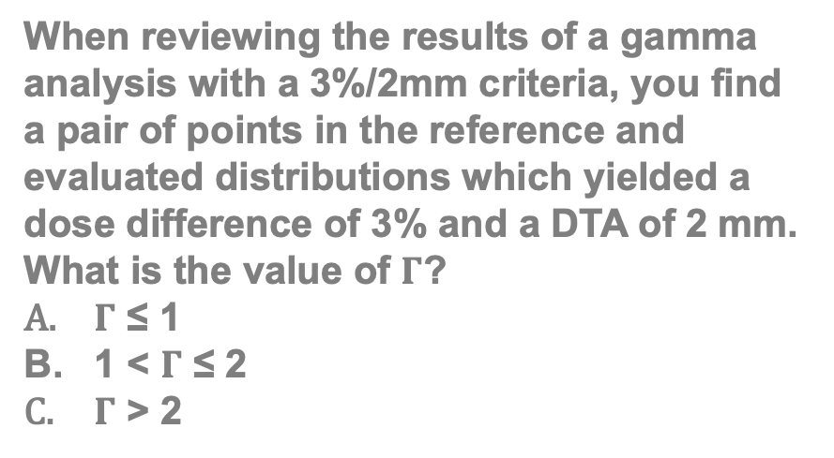
Question for the audience:
∆D [%]
When reviewing the results of a gamma analysis with a 3%/2mm criteria, you find a pair of points in the reference and evaluated distributions which yielded a dose difference of 3% and a DTA of 2 mm. What is the value of $Γ$?
$Γ$ ≤ 1
1 < $Γ$ ≤ 2
$Γ$ > 2
(2 mm, 3%)
3%
2 mm
∆d [mm]
$$Γ=\sqrt{\frac{{\left(3\%\right)}^{2}}{{\left(3\%\right)}^{2}}+\frac{{\left(2 mm\right)}^{2}}{{\left(2 mm\right)}^{2}}}=\sqrt{2}$$
Bonus: Does this mean this point fails?

Slide 13
Example Gamma Index Values and their relation to DTA/DD
For 3%/3mm criteria:
DTA = 0 mm | DD = 1% | γ = 0.33
DTA = 1 mm | DD = 1% | γ = 0.47
DTA = 2 mm | DD = 1% | γ = 0.75
DTA = 2 mm | DD = 2% | γ = 0.94
DTA = 3 mm | DD = 3% | γ = 1.41
DTA = 3 mm | DD = 3% | γ = 1.41
DTA = 4.5 mm | DD = 0% | γ = 1.5
In the extremes (either DTA or DD is 0), gamma index gives you the fractional value of the nonzero metric relative to its criterion

Slide 14
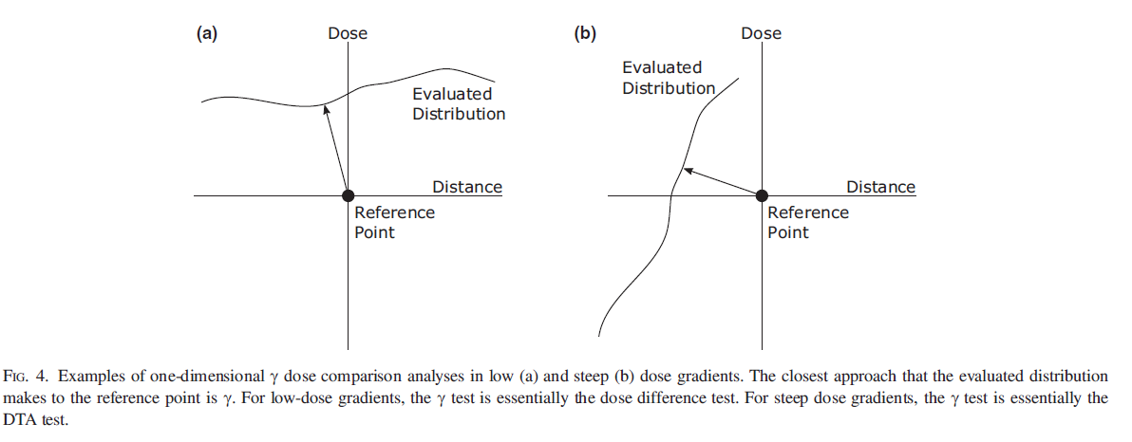
The gamma test under different dose gradient conditions
In low dose gradient regions, the dose difference test dominates
In high dose gradient regions, the DTA test dominates

Slide 15
Gamma – Strengths and Weaknesses
Strengths:
Benefits of composite test with the addition of quantitative information
Widely accepted QA metric across clinics
Reduces sensitivity steep dose gradient regions (*next slide)
Limitations
Interpretation of results is not necessarily straightforward
Does not inherently provide site-specific feedback

Slide 16
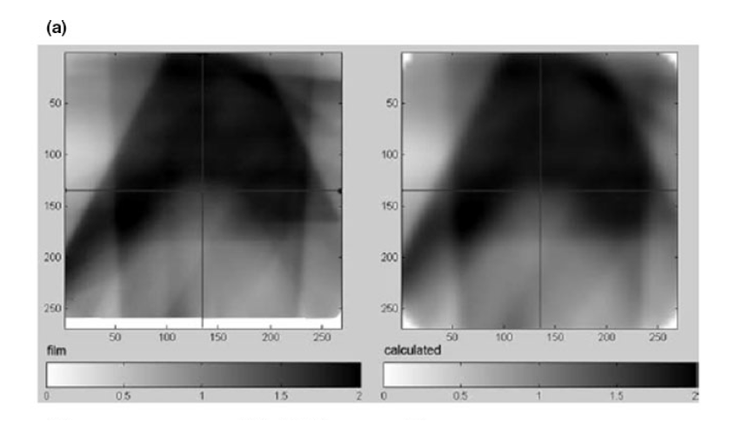
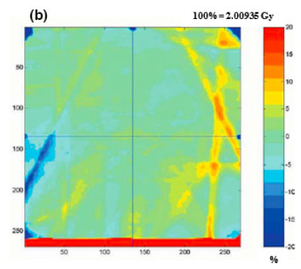
Dose difference vs gamma
For steep dose gradients with a nonzero DTA tolerance, it may not be violated for large dose differences
FILM
CALCULATED
Dose Difference

Slide 17
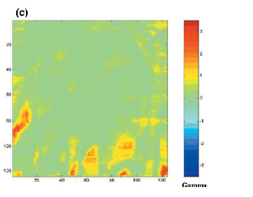
Dose difference vs gamma
For steep dose gradients with a nonzero DTA tolerance, it may not be violated for large dose differences
FILM
CALCULATED
GAMMA

Slide 18
Calculation parameters to consider…
Normalization
Spatial resolution
Interpretation

Slide 19
Normalization
Global - Dose as a percentage of maximum dose for one or both of the dose distributions or as function of the prescription dose. All dose point pairs are normalized using the same value for all point pairs.
Local - the dose is normalized to the planned dose at each location for each point pair
Allows the same relative tolerances in the target and critical structure regions
Unrealistic dose accuracy requirements in low-dose regions
Global vs local normalization is not as sensitive within the target region
The difference between the two is smallest in high dose areas

Slide 20
Normalization – Question for the Audience
Let’s say the dose is normalized to the max in the reference distribution, for example 200 cGy = 100%. Let’s say we look at a point in the low dose region of the reference distribution, which measures 20 cGy (10%), and its corresponding point in the evaluated distribution, which measures 21 cGy (10.5%). This gives a dose difference of 0.5% which will likely be acceptable. What happens if we used local normalization instead?

Slide 21
Normalization – Question for the Audience
Let’s say the dose is normalized to the max in the reference distribution, for example 200 cGy = 100%. Let’s say we look at a point in the low dose region of the reference distribution, which measures 20 cGy (10%), and its corresponding point in the evaluated distribution, which measures 21 cGy (10.5%). This gives a dose difference of 0.5%, which will likely be acceptable. What happens if we used local normalization instead?
If we used local normalization, then 20 cGy = 100%, and 21 cGy = 105%, and we get a 5% dose difference. Therefore, local normalization is a more stringent test.

Slide 22
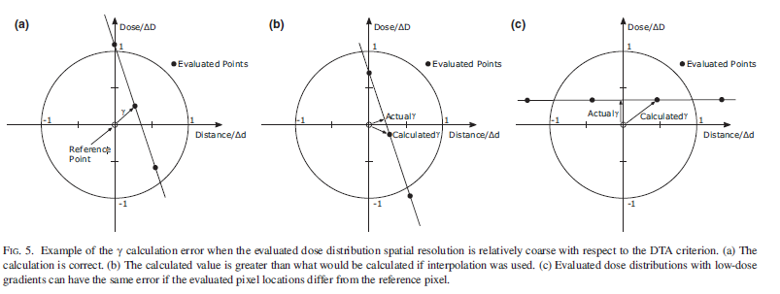
Spatial resolution
Spatial resolution has a big impact on accuracy of comparing dose distributions
Impacts gamma significantly for steep gradient regions (large error if no interpolation is used)
Ratio of DTA criterion to grid spacing is your limit of DTA accuracy
Good rule of thumb, keep resolution at or below 1/3 of DTA criterion
High dose gradient error
Calculation value greater
than if interpolation is used
Calculation correct
Low dose gradient error
Notes:
Increase accuracy and decrease speed of the gamma calculation
Good rule of thumb is that resolution of the evaluated dose should be no greater than 1/3 of the DTA criterion (max gamma error is roughly the ratio of the spacing to the DTA criterion)

Slide 23
Interpretation
Thresholding for gamma analysis
Doses smaller than a certain value are not included
It focuses on greater (clinically relevant) doses
One result is higher passing rates
Pass/fail criteria
Helpful when displayed as a histogram
Is it failing in the high or low dose region?
How many points are failing?
TG-218 Recommendations regarding Gamma Analysis:
3%/2mm criteria
Global Normalization
95% tolerance limit for passing rate
90% action limit for passing rate

Slide 24
IMRT QA Delivery Techniques

Slide 25
Perpendicular composite
Mounted detector perpendicular to the beam direction
Advantage: All images integrated for single dose image analysis
Con: Errors from each field may cancel on summation
Con: VMAT delivery the dose rate variation vs gantry may be obscured
Report recommends against PC

Slide 26
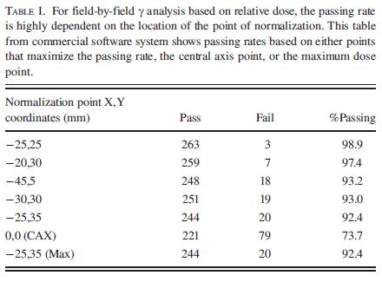
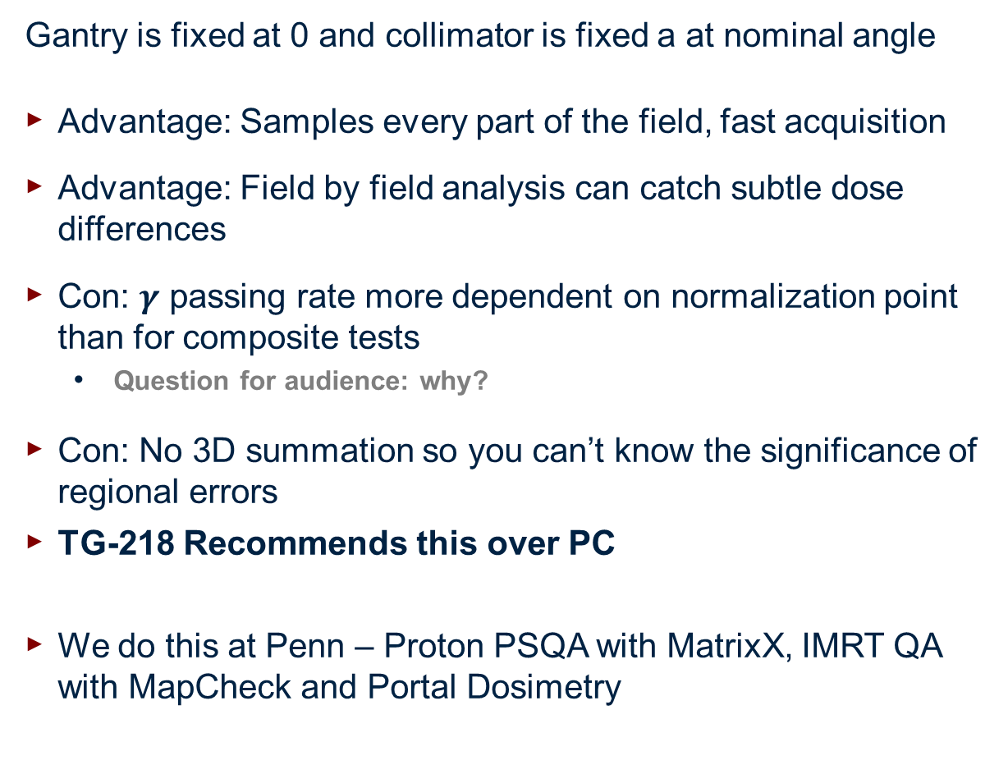
Perpendicular field by field (PFF)
Gantry is fixed at 0 and collimator is fixed a at nominal angle
Advantage: Samples every part of the field, fast acquisition
Advantage: Field by field analysis can catch subtle dose differences
Con: $γ$ passing rate more dependent on normalization point than for composite tests
Question for audience: why?
Con: No 3D summation so you can’t know the significance of regional errors
TG-218 Recommends this over PC
We do this at Penn – Proton PSQA with MatrixX, IMRT QA with MapCheck and Portal Dosimetry

Slide 27
True composite (TC)
Use real plan parameters
Advantage: uses actual gantry, collimator, couch angles. Includes inaccuracies/effects of:
Gantry, collimator, couch angles, and MLC leaf positions with gravitational effects
Couch top attenuation
Advantage: Provides an actual dose in a 2D plane of a 3D dose
proximity between the high dose region and organ at risk lying on a plane can be assessed
one dose image to analyze per plan
Con: does not sample every part of each beam if using 2D detector
Not true if using a 3D detector
TG-218 Recommends this over others, but PFF is also good
We do this at Penn with ArcCHECK
Notes:
For the film measurements, a reference field reading to a known dose, 10x10 at reference depth in a phantom
IC in a uniform dose region
Diode array
If you are using a diode array, you are worried if more than 20% of the dose comes laterally at the diode array.
Non-coplanar beams are also an issue for a diode array

Slide 28
Absolute dose verification
Single point (small averaged volume)
Cylindrical IC with stylized QA phantoms
Verify MU setting to absolute dose for a point location
Helpful for rescaling
Measurement preformed in a non-gradient region, where dose variation is within 5% of mean chamber dose to minimize volume averaging
2D methods (single field vs composite dose)
IC arrays, diode arrays, EPIDs, and film
Relative dose comparisons or be calibrated and used the measured absolute dose
Film provides the highest spatial resolution
3D methods
3D gels
PRESSAGE dosimeters
*Referred to TG-120 for IMRT implementation and commissioning
Notes:
Worry above volume averaging in the change. 5% of the mean chamber dose … for the min and max doses across the volume of the chamber

Slide 29
Suggestions for IMRT QA for fixed gantry and rotational
Should be performed with True Composite
provided the QA device has negligible angular dependence or the angular dependence is accounted for
PFF if the QA device is not suitable for TC
Do not use perpendicular composite (no rotation, all summed dose)
Analysis in absolute dose mode
Recommendation of a dose calibration should be done before each measurement session
Global normalization
should be used; deemed more clinically relevant than local normalization
normalization point should be selected in a low gradient region with a value ≥ 90% of the max dose in the plane of measurement
Local normalization
more stringent, only suggested during commissioning
Use a dose threshold, example of 10%
Tolerance limits for PFF and TC
Tolerance limit: Gamma pass rate should be ≥ 95% with 3%/2mm and 10% dose threshold
Action limit: Gamma pass rate should be ≥ 90% with 3%/2mm and 10% dose threshold

Slide 30
Suggestions for IMRT QA for fixed gantry and rotational
If a plan fails the action limit, do not deliver the plan clinically
Is it in a region that is clinically relevant
Tighter tolerance of 2%/1mm or 1%/1mm maybe necessary for specific treatment sites or delivery machine (SRS or SBRT)
IMRT with IC and film tolerance and action limit should be ≤2% and ≤3%
Any plan not at 100%, look at the following
Number of points failing
Histogram
Gamma analysis on a per structure basis
Track gamma passing rates across all patients
If your passing rates don’t match what is suggested in this document, revisit TG – 119
IROC Houston IMRT phantom suggested

Slide 31
Actions for failed or marginal QA results
When a failure occurs, investigate it using the following:
Set Up and Beam
IMRT QA software
Multileaf Collimator (MLC)
Treatment Planning System (TPS)

Slide 32
Actions for failed or marginal QA results
Set Up and Beam
Phantom setup
Correct plan version in R&V system
Correct plan generated, correct dose per fraction, correct delivery technique, and data transfer
Beam flatness, symmetry, and output on the day of measurement
Beam stability (with low MU)
Accuracy, stability, and calibration of measurement device
Detector size and interdetector spacing (especially for SRS)
Dose value of global normalization point
IMRT QA software
Correct reporting and handling of plan
Recheck Dose, DTA tolerance, threshold, registration of measured and calculation dose distributions

Slide 33
Actions for failed or marginal QA results
Multi-leaf Collimator
Review results of periodic general IMRT PSQA
Leaf tolerances (speed, position, acceleration/decleration)
Tongue and groove effects (may require high-resolution detector)
Beam profile data for both collimator and MLC defined fields
Dosimetric leaf gap
Intra and Inter leaf transmission
Jaw tracking positions (to minimize leaf transmission)

Slide 34
Actions for failed or marginal QA results
Treatment planning system
Amount of modulation and complexity of plan
Number of small segments
Total MU (affects transmission dose)
TPS modeling accuracy for small fields (OF, profiles & penumbra)
Characterization of leaf parameters (gap, leaf ends, transmission etc.)
Minimum MU
Minimum segment (or beamlet) size
Grid size (MC)
CT number to HU conversion
Multiple carriage beams
Gantry-angle spacing for VMAT delivery
All previous items checked during IMRT commissioning

Slide 35
Conclusions
Gamma pass rate per vendor were evaluated
Recommendation to vendors to work on their software and improve the additional source of uncertainty
Recommendations in TG 218 can be implemented at clinical level

Slide 36
EXTRA SLIDES Reported IMRT Measured vs. Calculated Methods Agreement Vendor Survey and Algorithm Testing Process Based Tolerance and Action Limits

Slide 37
Reported IMRT Measurement Methods
Survey of numerous institutions reported that they use:
64% field by field and 58% absolute dose (Nelms and Simon 2007)
Criteria
Dose difference
76.3% of institutions used 3%
2.9% of institutions used 4%
15.1% of institutions used 5%
Distance to agreement
82.7% of institutions used 3 mm
5.0% of institutions used 4 mm
2.6% of institutions used 5 mm
Threshold dose limits
34.5% of institutions used 0-5%
35.6% of institutions used 5-10%
28.8% of institutions used ≥ 10%

Slide 38
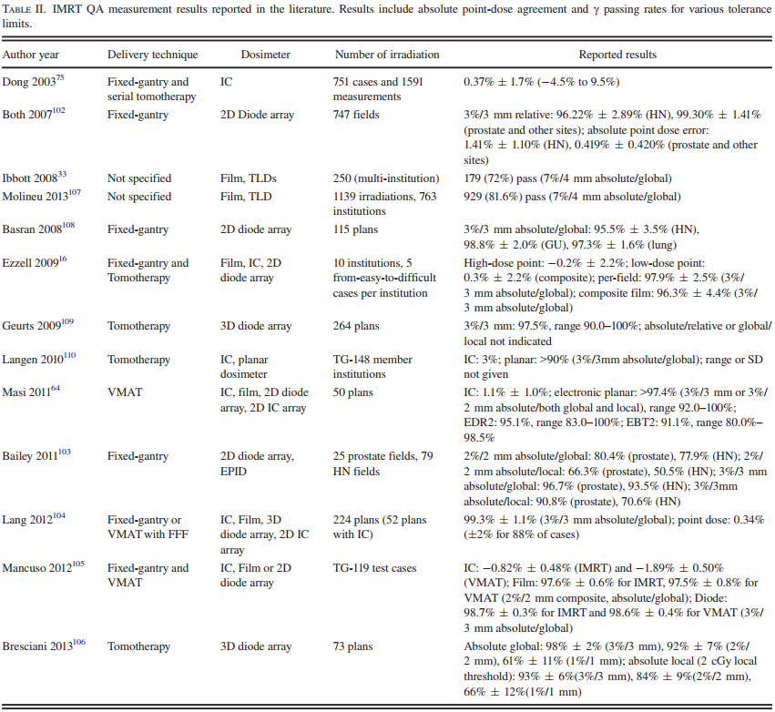
Reported IMRT Measurement
vs Calculated Agreement
IC tolerance is 5% of expected values
2D Gamma pass rates of >90% for 3%/3mm global normalization
Recent studies
For 3%/3mm criteria, plans should have around 100% of points passing
For 3%/2mm or 2%/2mm, plans should have pass rates with > 95% of the points passing

Slide 39
Delivery Methods - Fixed Gantry IMRT
IMRT – H&N QA
IROC the criteria for passing is 7% dose difference reported by the TLD in the PTV and 4 mm DTA for film in the dose gradient
Dong et al 2003- IROC for TLDS and film
71 institutions out of 250 failed the credentialing by IROC
71.6% passed the criteria and 28.4% failed
Hernandez et al 2013 – update of IROC study
156 out of 763 institutions failed credentialing by IROC
81.6% passed the criteria and 13.7% failed only TLD, 1.8% failed the film criteria, and 2.9% failed both criteria
This data highlights significance of IMRT verification QA

Slide 40
Delivery Methods – Volumetric Modulated Arc Radiotherapy
VMAT QA
Accurate MLC motion, gantry motion, and dose rate adjustment
Ion chamber measurements within 2.1% of MC and TPS, by Teke et al.
MLC leaf position errors within 1 mm, 94% of the time. All errors less than 2.5 mm by Teke et al.
Although one can calculate dose in 2 to 7 degree sectors, recommend sector calculation grid spacing of 4 degrees by Feygelmen et al
Single position, IC measured, mean dose errors were less than 0.5% +/- 1.4% for PTV and -0.3% +/- 1.4% for OAR.
VMAT vs IMRT – no significant differences in pass rates were found when using TG-119
phantom geometry

Slide 41
Delivery Methods – Other modalities
Flattening filter free
IMRT and VMAT pass rates for Gamma of 3%/3mm are good
Lower pass rates for a increasing ratio of MU to dose per fraction
more MU, more highly modulated plans, thus lower pass rates
Tomotherapy
Machine stability as reported by a study by Broggi et al
Couch –Gantry synchronization
Within 2mm over a 2 yr period
Gantry MLC within 1 degree
Dose rate variation within 1-2% during treatment
3%/3mm gamma was found be on average 97.5%
Correlation between IMRT QA and daily output QA for pass rates

Slide 42
Considerations when using the Gamma test passing rates for evaluation
Gamma can be insensitive to finding dose errors using single field measurements and certain delivery errors
Yan et al found that a 3%/3mm criteria and a 90% pass rate with a 2D diode array was only able to detect leaf positioning errors greater than 2 mm
Mu et al investigated the impact of the number of control points (50 vs more than 100) on passing rates for direct machine parameter optimization (DMPO) based plans
Worse results with more control points including D95% change between 4% and 8% and point dose to spinal cord/brainstem changed from 4% to 12%
Kry et al looked at the number of points failed for 2%/2mm and 3%/3mm (IROC H&N)
Fraction of pixels passing the gamma criteria from individual irradiation beams were a poor predictor of Dosimetry accuracy
Nelms et al investigated error induced places for MLC transmission and beam penumbra
IMRT QA was unable to show a correlation with errors and pass rates

Slide 43
Considerations when using the Gamma test passing rates for evaluation
Take away – tighter tolerances are needed, performing a thorough analysis, and routine QA of the accelerator and MLC are required to supplement IMRT QA
Clinical analysis of IMRT QA failure results is challenging
Issues with the Gamma test
Passing rate summarization has no spatial sensitivity
Clustering of failed points not considered
Large regions of low dose cause the fraction of points to appear small when the area of failed points is large compared to the high-dose regions (results in easy pass rates)

Slide 44
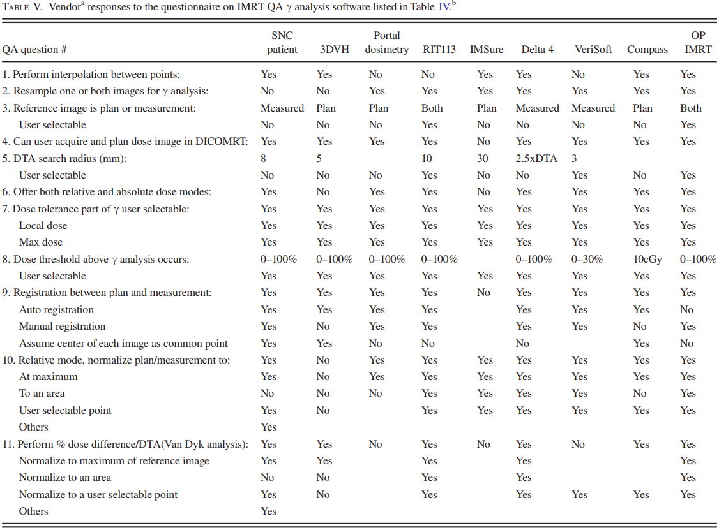
Vendor Survey and Algorithm Testing

Slide 45
Vendor Survey and Algorithm Testing

Slide 46
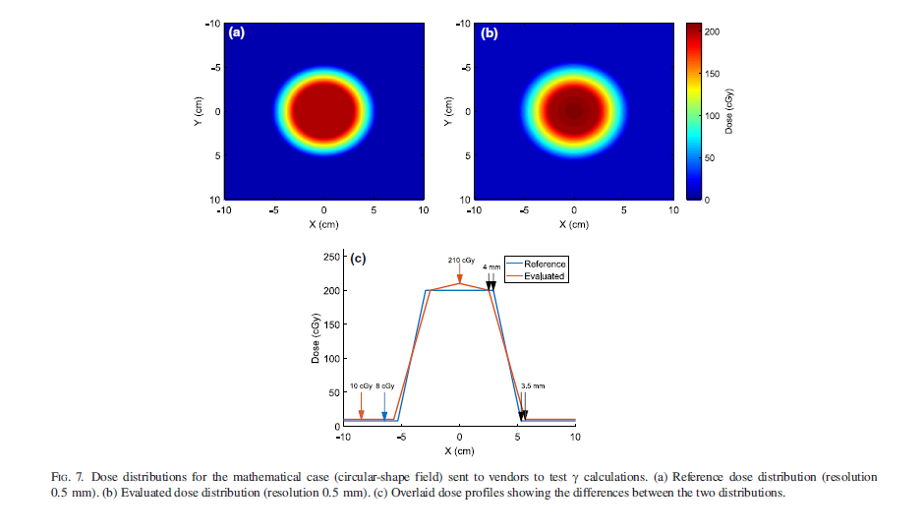
Testing of vendor algorithms
Composite test and gamma index can vary from vendor to vendor
Two dose distribution provided: (A) mathematical (ideal) and (B) clinical treatment plan
Notes:
In addition to the difference in QA tool designs, such as the detector type and electronics, the implementation of the same IMRT QA analysis method, such as composite test and gamma index, can vary from different vendors or even different products from the same vendors

Slide 47
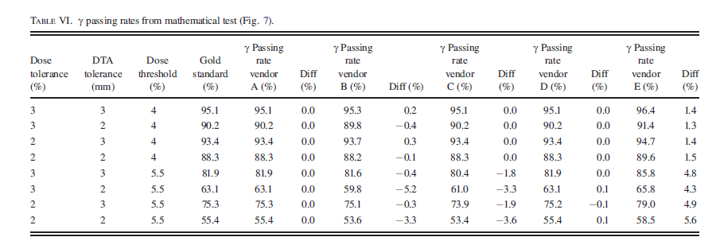
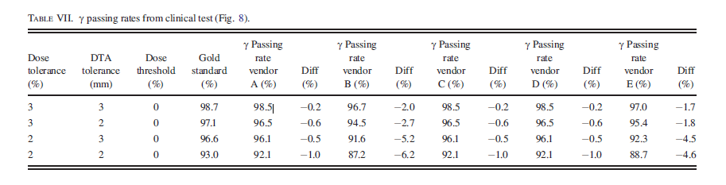
Testing of vendor algorithms
Results from different vendors [A,B,C,D,E], same plans
Ju et.al. Geometric interpretation of the gamma dose distribution comparison technique: interpolation-free calculation. Med Phys. 2008;35:879–887.

Slide 48
Testing of vendor algorithms
Results from different vendors [A,B,C,D,E], same plans

Slide 49
Testing of vendor algorithms
Results from different vendors [A,B,C,D,E], same plans

Slide 50
Testing of vendor algorithms
Results from different vendors [A,B,C,D,E], same plans

Slide 51
Testing of vendor algorithms
Mathematical test show good agreement (not perfect)
Difference in pass rates between ideal mathematical and clinical plan imply difference in dose align or handling of image resolution
Notes:
In addition to the difference in QA tool designs, such as the detector type and electronics, the implementation of the same IMRT QA analysis method, such as composite test and gamma index, can vary from different vendors or even different products from the same vendors.

Slide 52
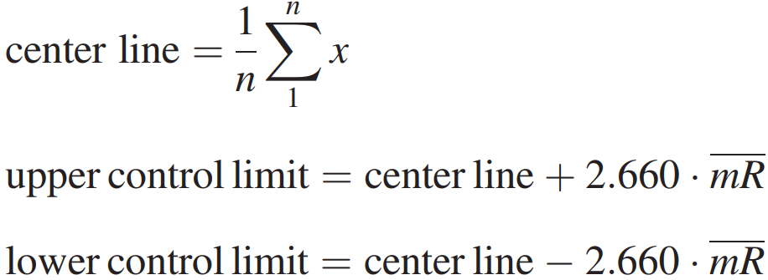
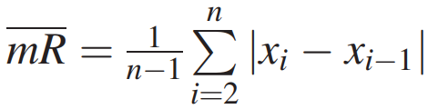
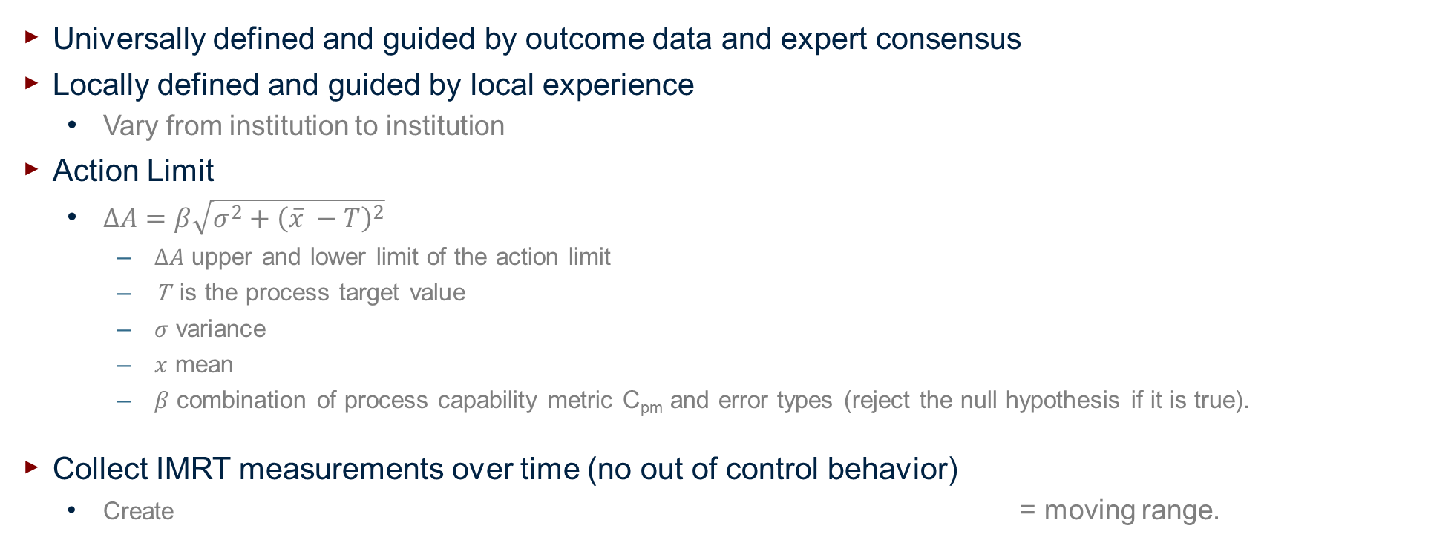
Process Based Tolerance and Action Limits
Universally defined and guided by outcome data and expert consensus
Locally defined and guided by local experience
Vary from institution to institution
Action Limit
$∆A=β\sqrt{σ^{2}+{\left(\overline{x} −T\right)}^{2}}$
$∆A$ upper and lower limit of the action limit
T is the process target value
$σ$ variance
$x$ mean
$β$ combination of process capability metric C_{pm} and error types (reject the null hypothesis if it is true).
Collect IMRT measurements over time (no out of control behavior)
Create = moving range.
Notes:
Action limit definition: Allowable deviation of measurement that won’t result in harm to the patient.
Tolerance limit definition: Are boundaries that, within, indicates that a process is subject to only random errors.

Slide 53
Examples of Process Based Tolerance and Action Limits
VMAT and fixed gantry IMRT QA
pass rate of 3% / 2 mm and 10% dose threshold
evaluated with ArcCHECK and MapCHECK device
20 plans with an average gamma of 96.66% for VMAT
Standard deviation of 1.739%
Moving range of 1.905%
Action limit is 22.6% according to their equation
100-22.6%/2= 88.7%
Control chart limit with no out of control behavior
96.66^ - 2.660*1.905% = 91.6% (using moving range)
20 plans for with an average gamma of 95.92% for IMRT
Standard deviation of 3.388%
Moving range of 3.642%
Action limit is 84.1%
Tolerance limit is 86.2%

Slide 54
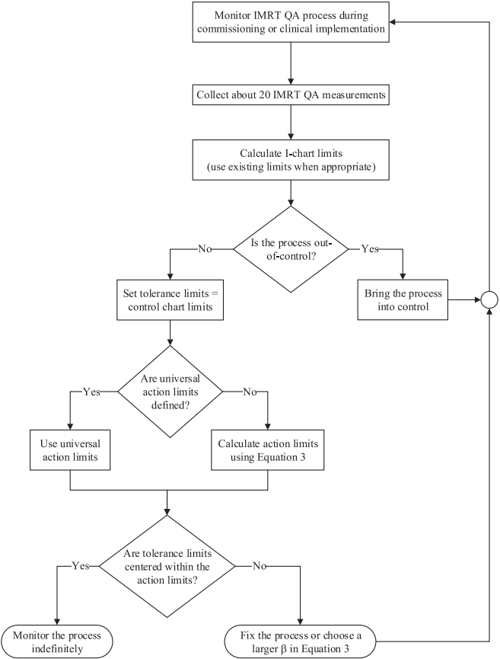
Recommendations
Flow chart outlines the procedure for setting
tolerance and action limits for IMRT QA

Slide 55
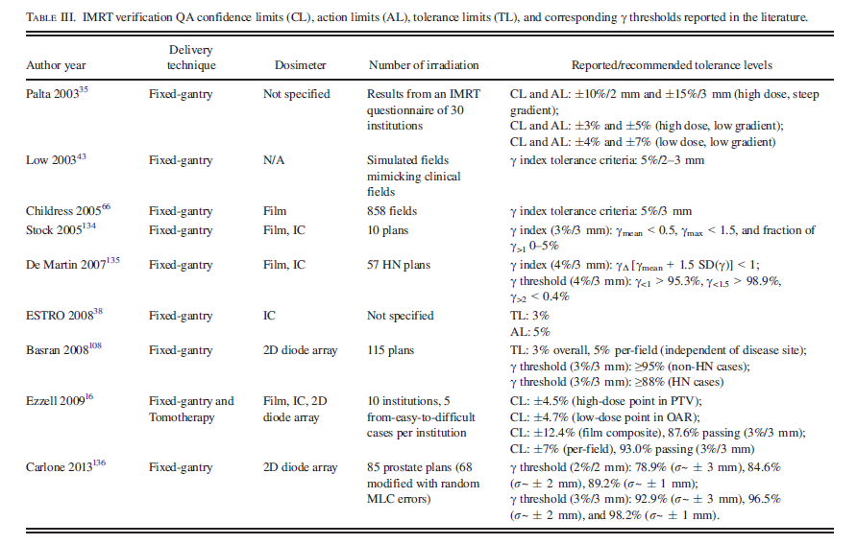
Passing rates for given tolerances and corresponding action limits
Notes:
A number of groups have suggested metrics to assess the clinical acceptability of IMRT QA verification plans.

Slide 56
Discussion questions
What would it look like to perform a local gamma analysis (as opposed to the usual global).
In target region?
In OARs?
In high gradient regions?
Why at Penn do we choose to perform gamma analysis for portal dosimetry, but DTA for ArcCheck?
What are the benefits/limitations of using a 3D dose reconstruction algorithm for IMRT QA?

